Slide 1
Face Recognition System using Eigenfaces
Ruja Bajracharya (074/BCT/055)
Sabudh Bahadur Thapa(074/BCT/059)
Sulav Bahadur Thapa(074/BCT/087)

Slide 2
Overview:
1.Introduction
2.Objective
3.Literature Review
4. Feasibility Study
5. Requirement Analysis
6.Block Diagram System Design and Architecture
7.Methodology
8.Expected Output

Slide 3
Introduction
Face Recognition is a biometric method of identifying an individual by comparing live capture or digital image data with the stored record for that person.
Face recognition can often prove one of the best biometrics because images can be taken without touching or interacting with the individual being identified, and those images recorded and instantly checked against existing databases.
It is the only biometric that allows passive identification in any environment.(example:identifying terrorist )
Facial Recognition is quickly becoming an integrated part of people’s everyday lives because it can be included in Retail Hospitality and Resorts, ATMs Digital Advertising, Bus Safety, Airlines, Personalized Customer Experience, Staff less Stores.
Implementation of efficient face recognition system using Eigenface method in Python

Slide 4
Objective
This proposed system will be able to detect and recognize human faces.
And it can also distinguish between multiple faces.

Slide 5
Literature Review
In 1964 and 1965, work related to recognising human faces started.
Advancing the accuracy of Facial Recognition- 1970s
In 1988, Kirby and Sirovich used standard linear algebra technique, to the face recognition
Until 1990s facial recognition systems were developed primarily by using photographic portraits of human faces and in the early 1990s with the principal component analysis(PCA). The PCA method of face detection is known as Eigenface by Matthew Turk and Alex Pentland.

Slide 6
Requirement Analysis
Functional Requirement
Should handle jpeg and png files
Should recognise high as well as standard quality image
Non Functional Requirement
24X7 efficient performance
Flexible for future extension

Slide 7
Requirement cont...
Software Requirement
Python
Visual Studio Code
Kaggle
Google Collab
Anaconda
Hardware Requirement
Webcam
PC/Laptop

Slide 8
Feasibility Study
Technically Feasible
Legally Feasible
Economically Feasible

Slide 9
System Diagram
Face Detection from camera
Output Image
Compute Eigenfaces
(eigenvectors of covariance matrix)
Calculate Euclidean
Distance between input face image and training samples
Acquiring Training
Samples
Find mean images
Find deviation and centered image
Project Testing Face image onto
The face space
Get its Eigenface Components
Initialise Face Recognition System
Recognise Unknown Face Images

Slide 10
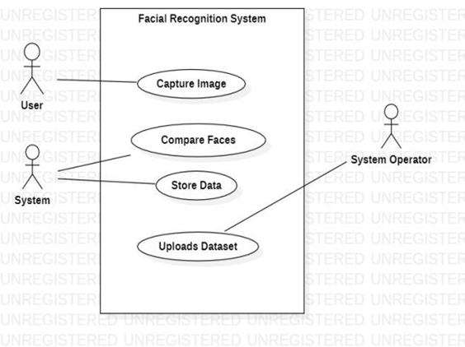
Use Case Diagram

Slide 11
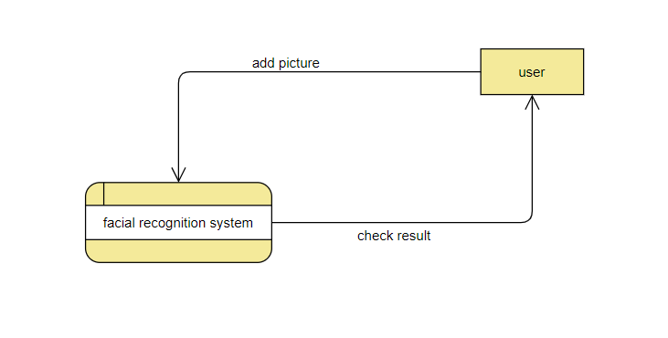
DFD 0

Slide 12
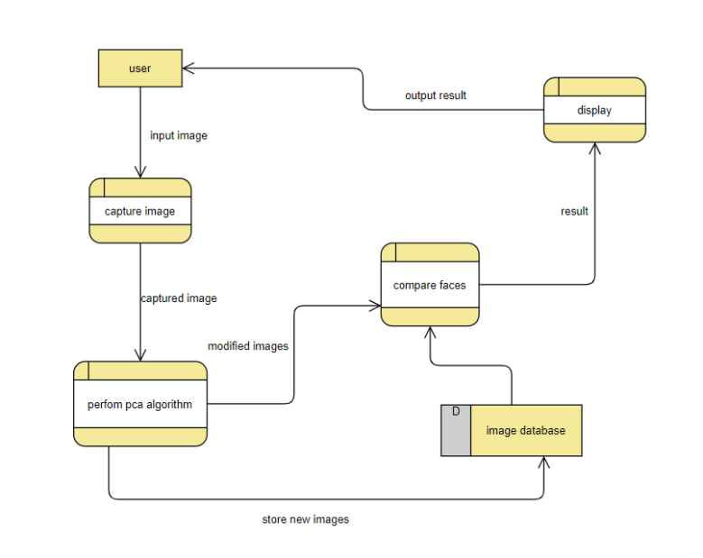
DFD 1

Slide 13
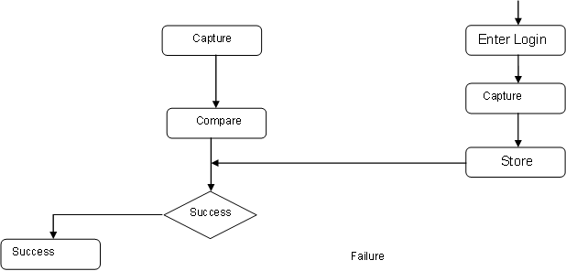
Flowchart

Slide 14
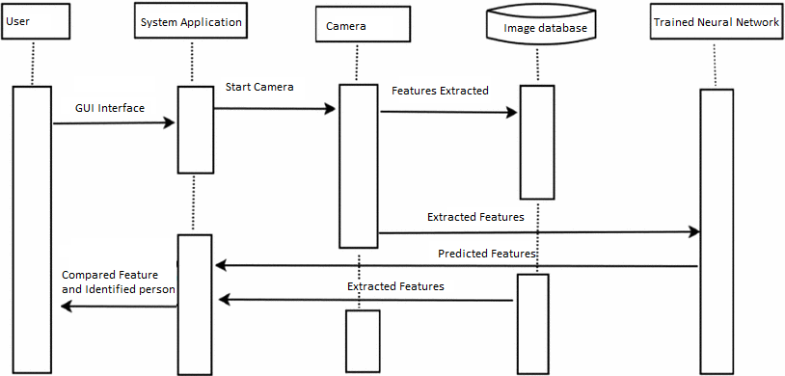
Sequence Diagram

Slide 15
Methodology
Iterative method
Requirements are properly defined and understood.

Slide 16
Dataset
Dataset obtained from Kaggle.

Slide 17
What is Eigenfaces?
Eigenfaces are the Eigenvectors of Covariance matrix of the dataset.
Eigenfaces are also known as ghostly images.
The main reason to use this is that it represents the input data efficiently-each individual faces can be represented in terms of linear combination of eigenfaces
Principal Component Analysis(PCA) plays a vital role in dimensionality reduction.

Slide 18
Why Eigenfaces?
Eigenfaces are mostly used to:
a. Extract the relevant facial information, which may or may not be directly related to human intuition of face features such as the eyes, nose, and lips. One way to do so is to capture the statistical variation between face images.
b. Represent face images efficiently. To reduce the computation and space complexity, each face image can be represented using a small number of dimensions

Slide 19

Eigen Computation
Steps Followed in Eigen Computation:
* Compute an average face.
mean = sum of all numbers / total no. of numbers
* Build a covariance matrix.

Slide 20
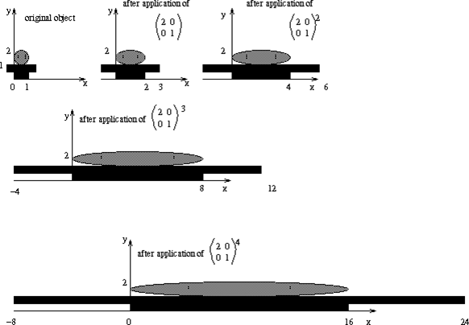
* Compute eigenvalues and eigenvector

Slide 21
contd….
* Select only sixteen largest eigenvalues (and its corresponding eigenvectors)
* Compute the faces using our eigenvectors
*Euclidean distance
To recognise faces, gallery images – those seen by the system – are saved as collections of weights describing the contribution each eigenface has to that image. When a new face is presented to the system for classification, its own weights are found by projecting the image onto the collection of eigenfaces. This provides a set of weights describing the probe face. These weights are then classified against all weights in the gallery set to find the closest match. A nearest-neighbour method is a simple approach for finding the Euclidean distance between two vectors, where the minimum can be classified as the closest subject.

Slide 22
Expected Output
After completion of the project, developed system should be able to recognize the given unknown face by comparing it with the stored records/ existing datasets.

Slide 23
THANK YOU!!

